Slide 1


Text to Image Generation
This presentation outlines the Text to Image Conversion project, exploring the challenges and opportunities in this emerging field. It details the project's goals, methodology, and anticipated outcomes.

Slide 2

Team Members
BHAGYODAYA VARSHNEY
SHRAY GUPTA
D-28
C-34
(2115000284)
(2115000968)
VANSH VERMA
YASH PATEL
K-59
D-52
(2115001089)
(2115001156)

Slide 3
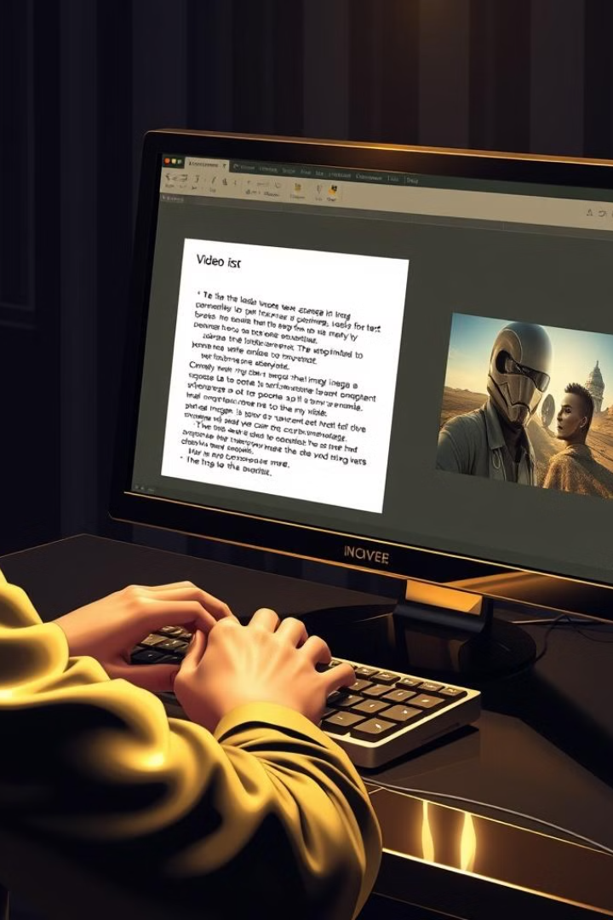
Introduction to Text to Image/Video Conversion
Text-to-image/video conversion involves generating visual content from textual descriptions. This rapidly developing area leverages artificial intelligence, specifically deep learning, to translate textual information into realistic or artistic images and videos.
1
Textual Input
2
Image Generation
The process begins with textual input, which can range from simple descriptions to complex narratives.
Advanced algorithms translate the text into visual representations, capturing the essence of the description.
3
Applications
4
Challenges
Applications are widespread, including content creation, entertainment, and even scientific visualization.
Despite the progress, challenges remain, such as generating accurate representations and handling complex concepts.

Slide 4
Motivation and Objectives
This project aims to contribute to the advancement of text-to-image conversion technology, focusing on developing a robust and efficient system that can accurately translate textual descriptions into high-quality visual outputs.
Motivation
Objectives
Impact
The project is driven by the need to explore the possibilities of artificial intelligence in visual content creation.
The objectives include developing a comprehensive system, exploring diverse applications, and addressing the challenges of accuracy and fidelity.
The research aims to contribute to the field of computer vision and create impactful applications in various domains.

Slide 5

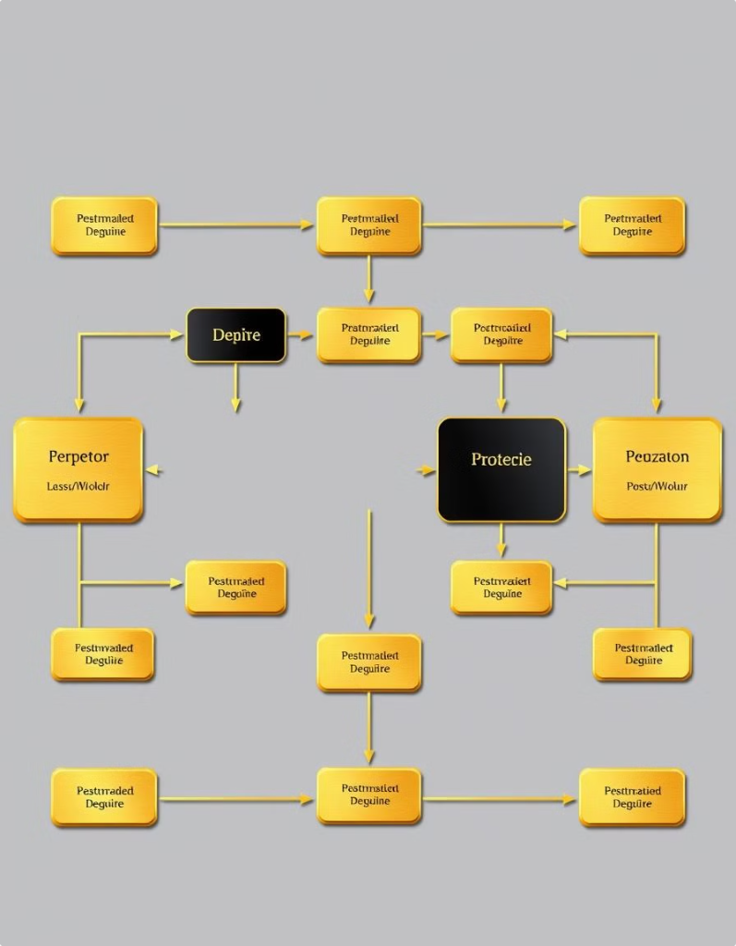
Proposed Approach
The project utilizes a deep learning approach, leveraging a combination of convolutional neural networks (CNNs) and recurrent neural networks (RNNs) to process textual input and generate corresponding visual outputs.
1
Data Acquisition
Collecting a diverse and high-quality dataset of textual descriptions and corresponding images/videos is crucial.
2
Model Training
The deep learning model is trained on the acquired dataset, learning to associate textual features with visual representations.
3
Model Evaluation
Evaluation metrics are employed to assess the model's performance in generating accurate and visually appealing images/videos.
4
Refinement
Based on the evaluation, the model is further refined and optimized for better performance and efficiency.

Slide 6

Technical Challenges
Developing a robust text-to-image conversion system involves addressing several technical challenges that necessitate innovative solutions.
Accuracy
Fidelity
Ensuring that the generated visual outputs accurately reflect the textual descriptions requires sophisticated algorithms and extensive training data.
Maintaining the fidelity of the generated images, preserving details and capturing the essence of the textual input, is a key challenge.
Complexity
Efficiency
Handling complex textual descriptions, including abstract concepts and nuanced narratives, poses significant challenges for current algorithms.
The computational resources required for training and running the model need to be optimized for efficiency, considering real-world applications.

Slide 7
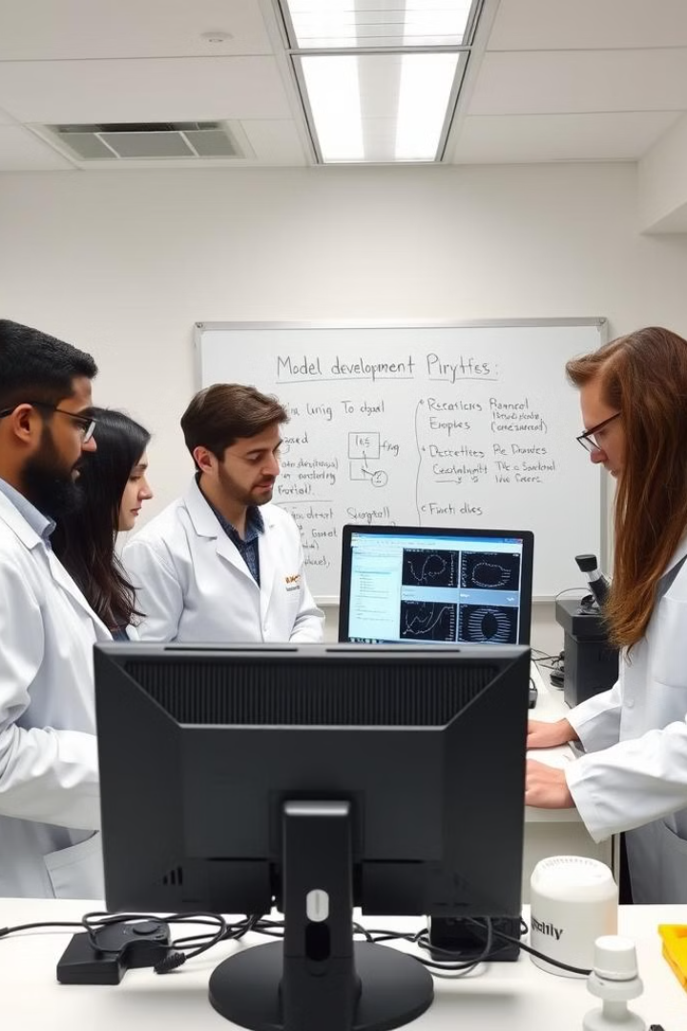
Methodology
The project employs a structured methodology, encompassing data acquisition, model development, training, evaluation, and refinement, to address the technical challenges and achieve the project objectives.
Stage
Description
Data Acquisition
Collecting a diverse and representative dataset of textual descriptions and corresponding images/videos.
Model Development
Designing and implementing the deep learning model architecture, incorporating CNNs and RNNs.
Training
Training the model on the acquired dataset, optimizing parameters and improving performance.
Evaluation
Assessing the model's accuracy, fidelity, and efficiency using relevant metrics.
Refinement
Iteratively refining and optimizing the model based on evaluation results, addressing weaknesses and improving overall performance.

Slide 8
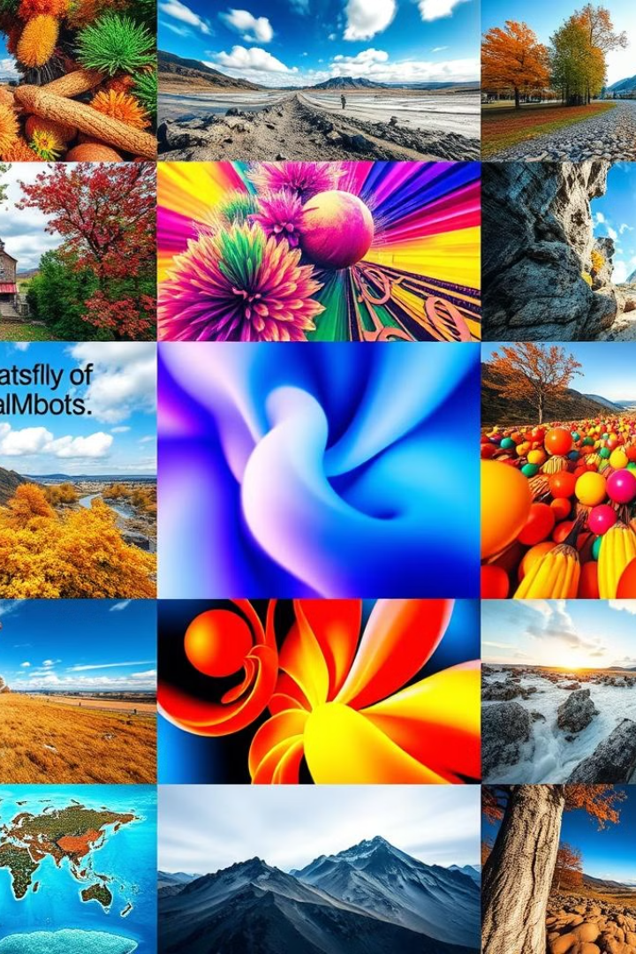



Expected Outcomes
The successful completion of this project is anticipated to yield significant outcomes, contributing to the field of text-to-image/video conversion and opening doors for innovative applications.
Functional System
Development of a functional and robust text-to-image/video conversion system capable of generating accurate and visually appealing outputs.
Applications
Exploring diverse applications of the developed system, including content creation, entertainment, and scientific visualization.
Knowledge Advancement
Contributing to the understanding of deep learning techniques and their application in text-to-image/video conversion.

Slide 9





Next Steps and Conclusion
The project's next steps involve continued research and development, focusing on addressing the remaining challenges and expanding the system's capabilities.
Future Research
Dataset Expansion
Exploring advanced deep learning techniques, addressing complex textual descriptions, and improving efficiency.
Enhancing the dataset with more diverse and high-quality textual descriptions and corresponding images/videos.
Application Development
Collaboration
Developing real-world applications of the system in various domains, showcasing its practical utility.
Collaborating with researchers and industry professionals to advance the field and explore new possibilities.

